Slide 1
Graph Convolutional Policy Network
Shanxiu He, Howard Xie, Justin Yi
Original paper by: Jiaxuan You, Bowen Liu, Rex Ying, Vijay Pande, Jure Leskovec

Slide 2
Contents
Motivation
Introduction
Methods
Experiments & Demo
Discussion & Conclusion

Slide 3
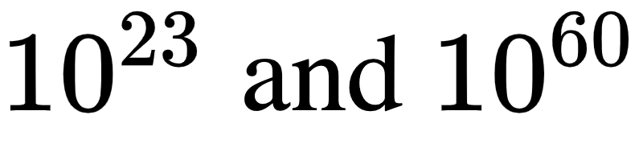
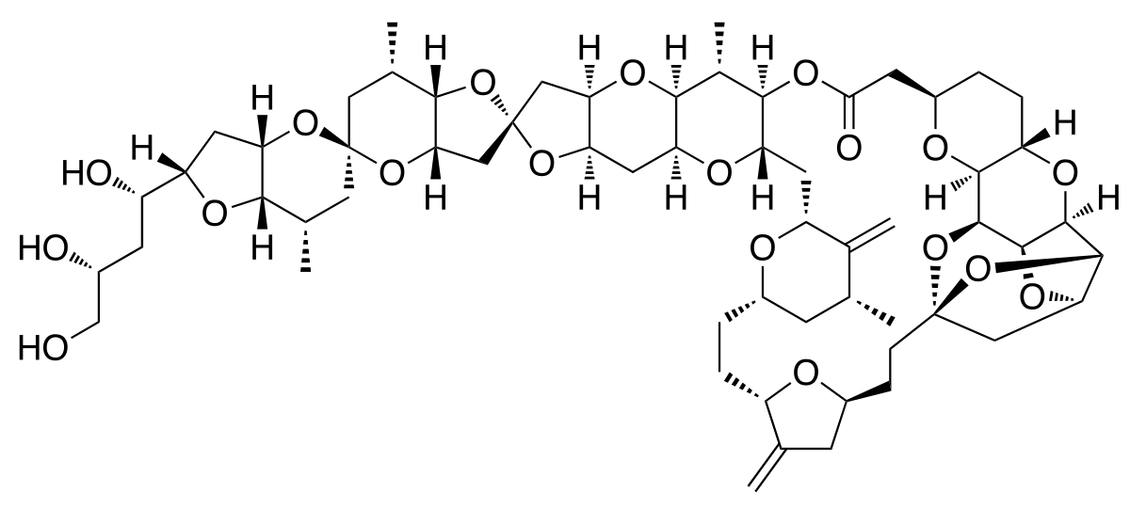
Motivation
Many important problems in drug discovery and material science are based on the principle of designing molecular structures with specific desired properties
However, the space of drug-like molecules is estimated to be in the range of
E7130
Notes:
Treatment for tumors, most synthetically complex drug

Slide 4
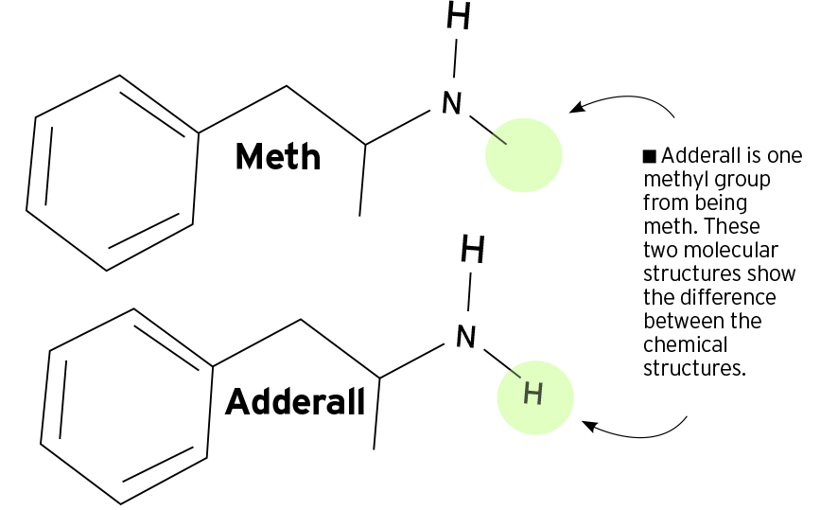
Motivation
Additionally, chemical space is discrete, and molecular properties are highly variable to small changes in molecular structure.
Increased effectiveness of the design of new molecules with application-driving goals would dramatically accelerate the development of novel medicines and materials.

Slide 5
Introduction & Background

Slide 6
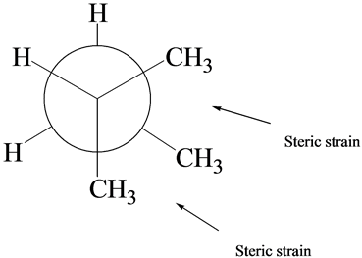
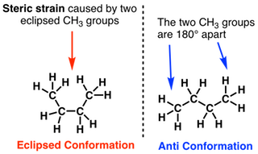
Introduction
Graph Convolutional Policy Network (GCPN)
Molecule generation process can be guided towards desiderata while constraining the output space to chemical rules
Valency
Octanol-water partition coefficient
Tendency of chemical to partition itself between organic phase and aqueous phase
Druglikeness
Molecular weight (MW)
Steric Strain
Notes:
Low Kow values may be considered relatively hydrophilic, high Kow => hydrophobic

Slide 7
Introduction
GCPN employs three well studied concepts
Graph Representation
Utilizes a Graph Convolutional Network (GCN) to compute node embeddings and a policy on which Markov Decision Process (MDP) is defined
Reinforcement Learning (RL)
Agent acts on an iterative graph generation process taking the intermediate generated graph as the state and chemical bonds to different atoms as the action space, governed by universal chemical principles via domain specific reward design.
Adversarial Training
Generative Adversarial Network (GAN) framework to define adversarial rewards to ensure generated molecules resemble expert samples

Slide 8
Introduction
Evaluation subdomains
Property Optimization
Property Targeting
Specify a target range for particular properties
Constrained Property Optimization

Slide 9
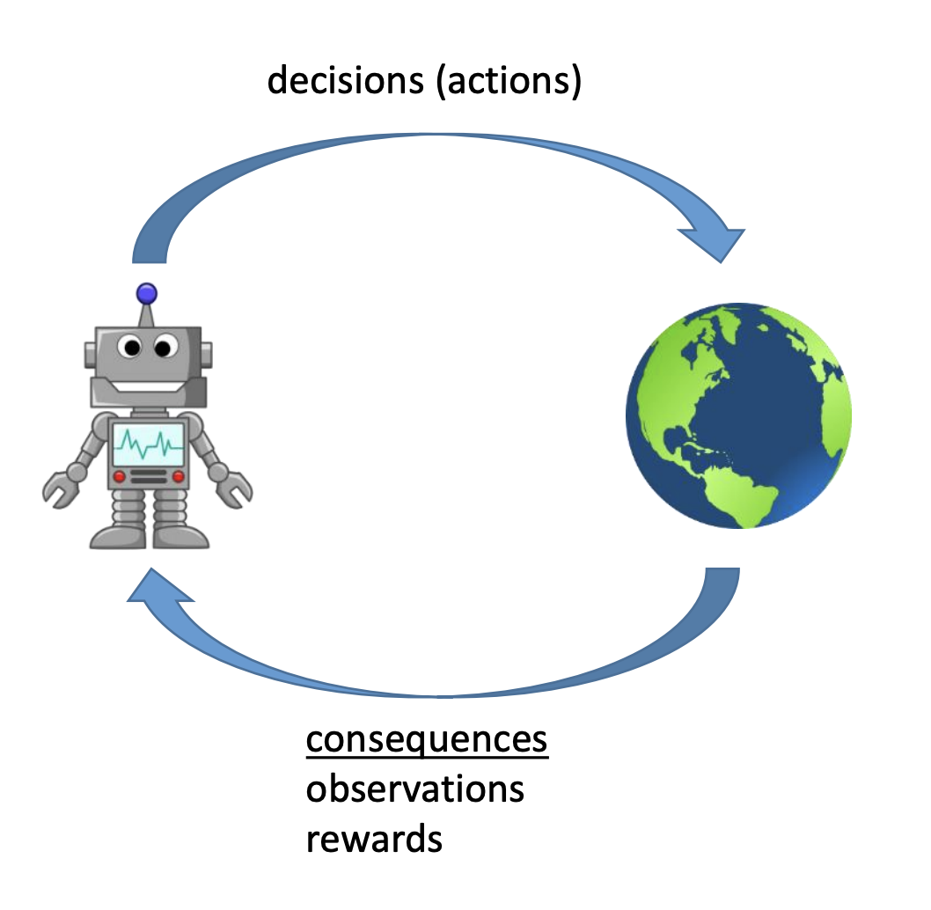
Reinforcement Learning Overview
Agent: takes observations from environment and makes actions
Environment: the world the agent inhabits
Desiderata: Agent to take best sequence of actions to complete a task of interest

Slide 10
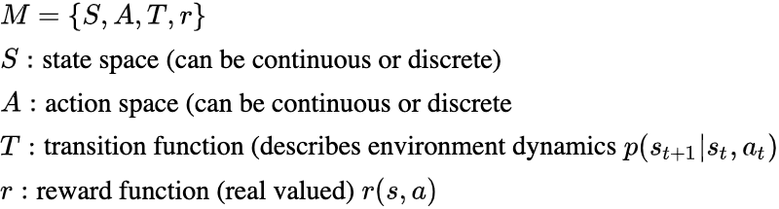
Markov Decision Processes (MDP)
State must contain all information about environment necessary for agent to act optimally
Markov Property: Next state is conditionally independent of previous states + actions given current state + action

Slide 11
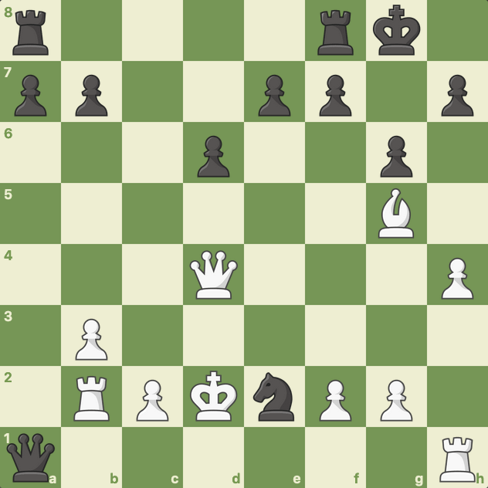
Markov Decision Processes (MDP)

Slide 12
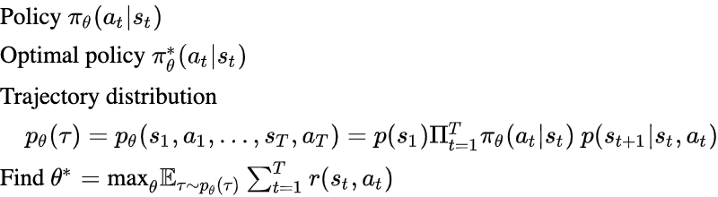
RL Objective

Slide 13
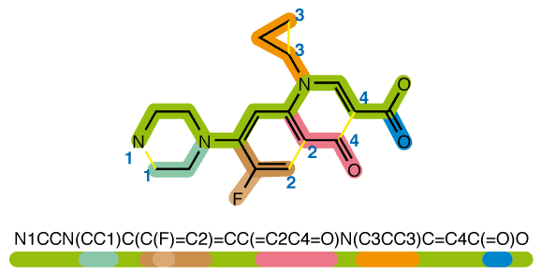
Related Work
Recurrent neural network (RNN) using simplified molecular-input line-entry system (SMILES) string generator using Monte Carlo (MC) tree search and policy gradient.
Variational Autoencoder (VAE) framework, where molecules are represented as junction trees of small clusters of atoms
Various sequential graph generation models that are able to specify target molecular properties

Slide 14
High Level Description
Molecule is constructed by
1) connect a new substructure or an atom with an existing molecular graph
2) add bonds to existing atoms
GCPN predicts the action of the bond addition
1) train via policy gradient to optimize both property objectives & adversarial loss
Adversarial loss is provided by a graph convolutional network

Slide 15
Methods
Model Introduction & Problem Definition
Graph Generation
Generation Environment
GCPN
Policy Gradient Training

Slide 16
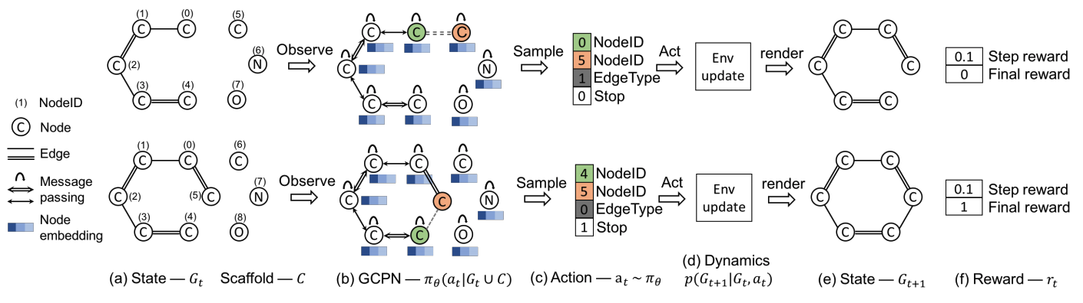
Graph Convolutional Policy Network (GCPN)
(a): State is defined as intermediate graph and the set of scaffold subgraphs is appended for GCPN calculation

Slide 17
Graph Convolutional Policy Network (GCPN)
(b): GCPN conducts message passing to encode state as node embeddings and produces a policy

Slide 18
Graph Convolutional Policy Network (GCPN)
(c): Four component action is sampled from the policy

Slide 19
Graph Convolutional Policy Network (GCPN)
(d): Environment performs a valency check on intermediate state for structure validity

Slide 20
Graph Convolutional Policy Network (GCPN)
(e): Next state is returned
(f): Associated reward is returned

Slide 21
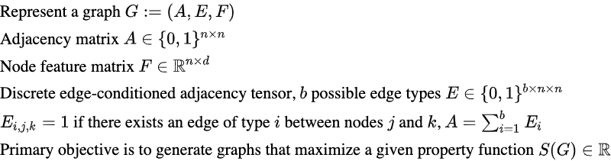
Formal Problem Definition
Notes:
\text{Represent a graph } G := (A,E,F)\\
\text{Adjacency matrix } A\in \{0,1\}^{n \times n}\\
\text{Node feature matrix } F \in \mathbb{R}^{n \times d}\\
\text{Discrete edge-conditioned adjacency tensor, $b$ possible edge types } E \in \{0,1\}^{b \times n \times n}\\
E_{i,j,k} = 1 \text{ if there exists an edge of type $i$ between nodes $j$ and $k$, } A = \sum_{i=1}^b E_i\\
\text{Primary objective is to generate graphs that maximize a given property function } S(G) \in \mathbb{R}

Slide 22
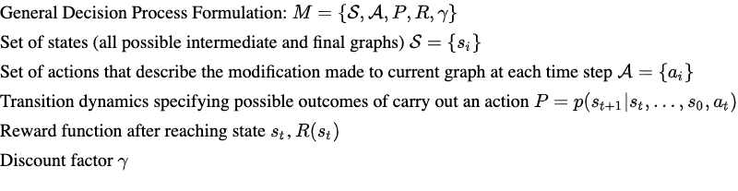
2. Graph Generation
as a Markov Decision Process (MDP)
Notes:
\text{General Decision Process Formulation: } M = \{\mathcal{S}, \mathcal{A}, P, R, \gamma\}\\
\text{Set of states (all possible intermediate and final graphs) }\mathcal{S} = \{s_i\}\\
\text{Set of actions that describe the modification made to current graph at each time step } \mathcal{A} = \{a_i\} \\
\text{Transition dynamics specifying possible outcomes of carry out an action } P = p(s_{t+1}|s_t, \dots, s_0, a_t)\\
\text{Reward function after reaching state $s_t$, } R(s_t)\\
\text{Discount factor } \gamma\\

Slide 23
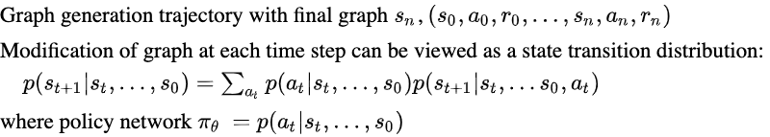
2. Graph Generation
as a Markov Decision Process (MDP)
Notes:
\text{Graph generation trajectory with final graph $s_n$, } (s_0, a_0, r_0, \dots, s_n, a_n, r_n)\\
\text{Modification of graph at each time step can be viewed as a state transition distribution: }\\ \quad p(s_{t+1}|s_t, \dots, s_0) = \sum_{a_t} p(a_t | s_t, \dots, s_0)p(s_{t+1}|s_t, \dots s_0, a_t)\\
\text{where policy network $\pi_\theta$ } = p(a_t | s_t, \dots, s_0)

Slide 24
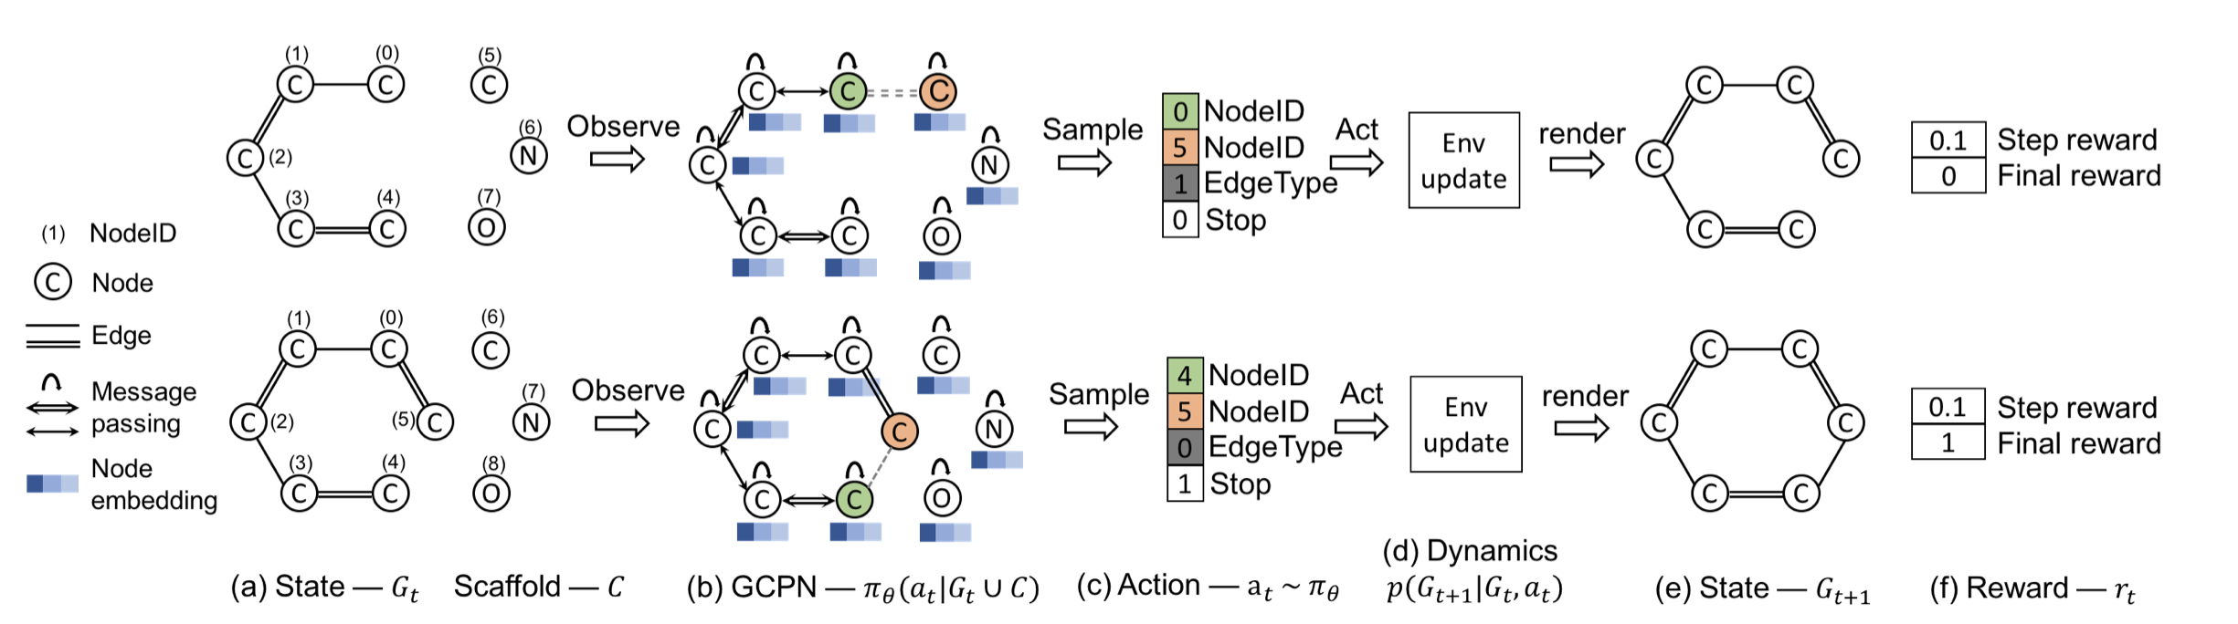
3. Molecule Generation Environment
State Space
Definition: The state space s_{t} is the generated graph G_{t} at time step t. (The boxes represent the state space before and after an action is taken.
Default: G₀ is assumed to be a single node represents a carbon atom.

Slide 25
3. Molecule Generation Environment
2.Action Space
(a link is predicted between the yellow and green atom)
Pre-defined a set of subgraphs C = {C₁, C₂, …, C_{s}}
Extended Graph at time t: G_{t} ∪ C
Action: Connect C_{i} ⊆ C to G_{t} or connecting existing nodes within G_{t} (all disconnected subgraphs are removed once an action is taken)

Slide 26
3. Molecule Generation Environment
3. State Transition Dynamics
Constraints: Infeasible actions proposed by the policy network are rejected
(Graph remains unchanged; Rules such as valency check)

Slide 27
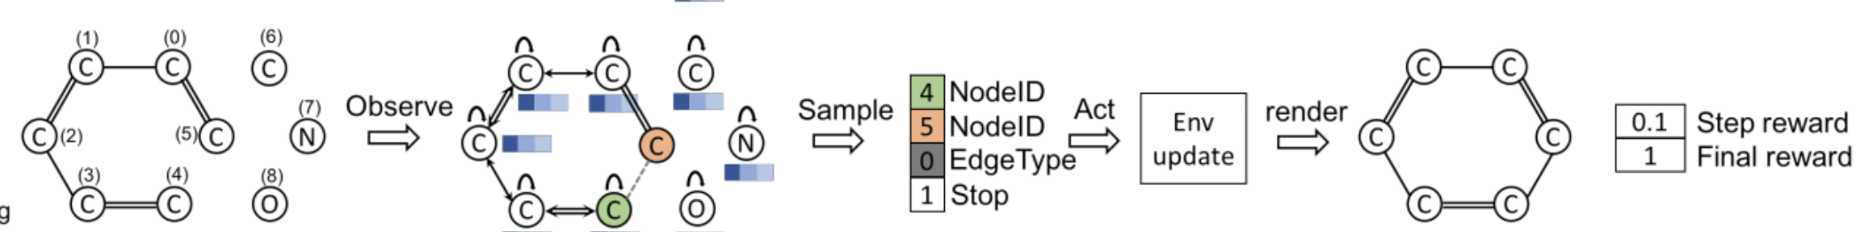
3. Molecule Generation Environment
4. Reward Design
Final Reward = All Domain Specific Rewards + Adversarial Rewards
Generation stops when termination action is taken; Calculated Final Reward.
Domain Rewards:
Rewards on Octanol-water partition coefficient rewards (logP), druglikeness(QED) and molecular weight (MW);
Penalty on unrealistic molecules (criteria such as excessive steric strain)

Slide 28
3. Molecule Generation Environment
4. Reward Design
Intermediate Rewards:
Step-wise Validity Rewards (valency) + Adversarial Rewards

Slide 29
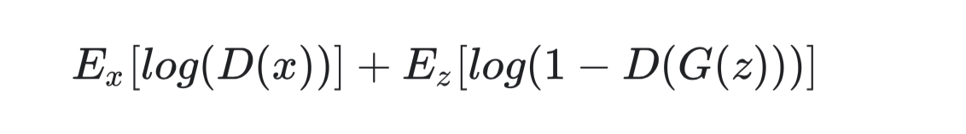
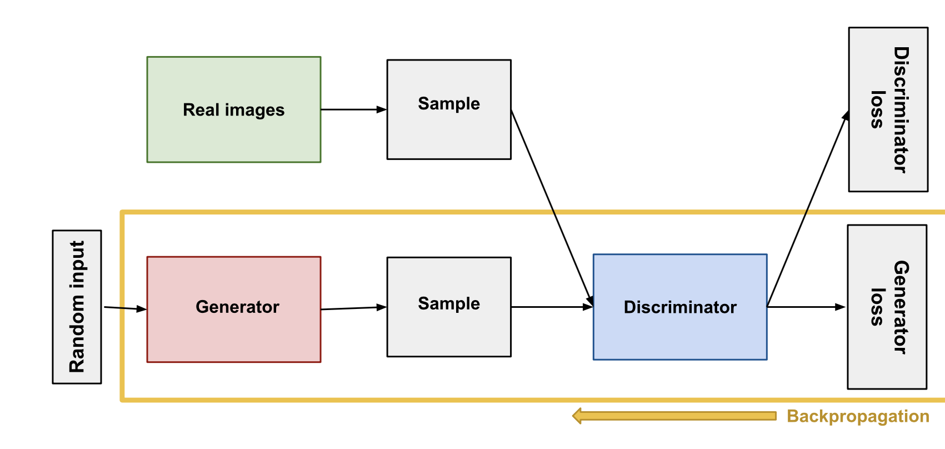
3. Molecule Generation Environment
4. Reward Design
GAN introduction
Discriminator & Generator train separately (different objectives)
Train until discriminator reaches about 50% accuracy
In this use case, we wish to train the network via
Discriminator Generator
Source: https://developers.google.com/machine-learning/gan/generator

Slide 30
3. Molecule Generation Environment
4. Reward Design
GAN introduction
In this use case, we wish to train the network so that our model could generate molecules that are similar to that from the actual data input
Discriminator Generator
Source: https://developers.google.com/machine-learning/gan/generator

Slide 31
3. Molecule Generation Environment
4. Reward Design
Adversarial Rewards
π_{θ} is the policy network
Dφ is the discriminator network
x represents an input graph
pdata is the underlying data distribution
(Takeaway: This is the rewards for discriminator; Generative Model is benefited from validity + final rewards)

Slide 32
4. GCPN
Input: intermediate graph G_{t} and the collection of subgraphs C
Output: action a_{t}, predicts a new link to be added
Node Embedding on high level:
To compute G_{t} ∪ C, first compute the node embedding of an input graph thorough GCN.
The authors adopt a variant that, in high level, perform message passing over each edge type for a total of L layers.

Slide 33
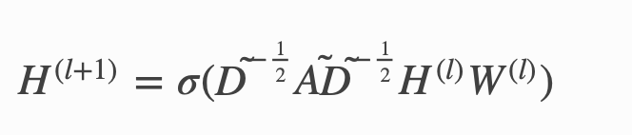
4. GCPN
Baseline GCN:
Node Embedding:
At the lth layer of the GCN, we aggregate all messages from different edge types to compute the next layer node embedding H^{(l+1)} ∈ R^{(n+c)×k}, where n, c are the sizes of G_{t} and C respectively, and k is the embedding dimension.
E_{i} is the i slice of edge-conditioned adjacency tensor E, and ~E_{i} = E_{i} + I; ~D_{i} =∑_{k} E_{ijk}.
W_{i}^{(l)} is a trainable weight matrix for the i^{th} edge type, and H_{i}^{(l)} is the node representation i learned in the l^{th} layer.
AGG(.) denotes functions which would be one of {MEAN, MAX, SUM, CONCAT}
We apply L layer GCN to compute the final node embedding matrix H^{(L)}
Notes:
(Recall that E has original dimension b * n * n)

Slide 34
4. GCPN
Node Embedding:
At the lth layer of the GCN, we aggregate all messages from different edge types to compute the next layer node embedding H^{(l+1)} ∈ R^{(n+c)×k}, where n, c are the sizes of G_{t} and C respectively, and k is the embedding dimension.
E_{i} is the i slice of edge-conditioned adjacency tensor E, and ~E_{i} = E_{i} + I; ~D_{i} =∑_{k} E_{ijk}.
W_{i}^{(l)} is a trainable weight matrix for the i^{th} edge type, and H_{i}^{(l)} is the node representation i learned in the l^{th} layer.
AGG(.) denotes functions which would be one of {MEAN, MAX, SUM, CONCAT}
We apply L layer GCN to compute the final node embedding matrix H^{(L)}
Notes:
(Recall that E has original dimension b * n * n)

Slide 35
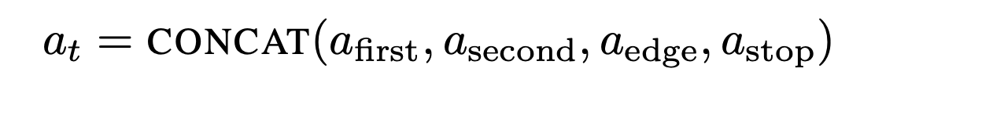
4. GCPN
2. Action Prediction
Action at at time step t: a concatenation of four components: selection of two nodes, prediction of edge type, and prediction of termination.

Slide 36
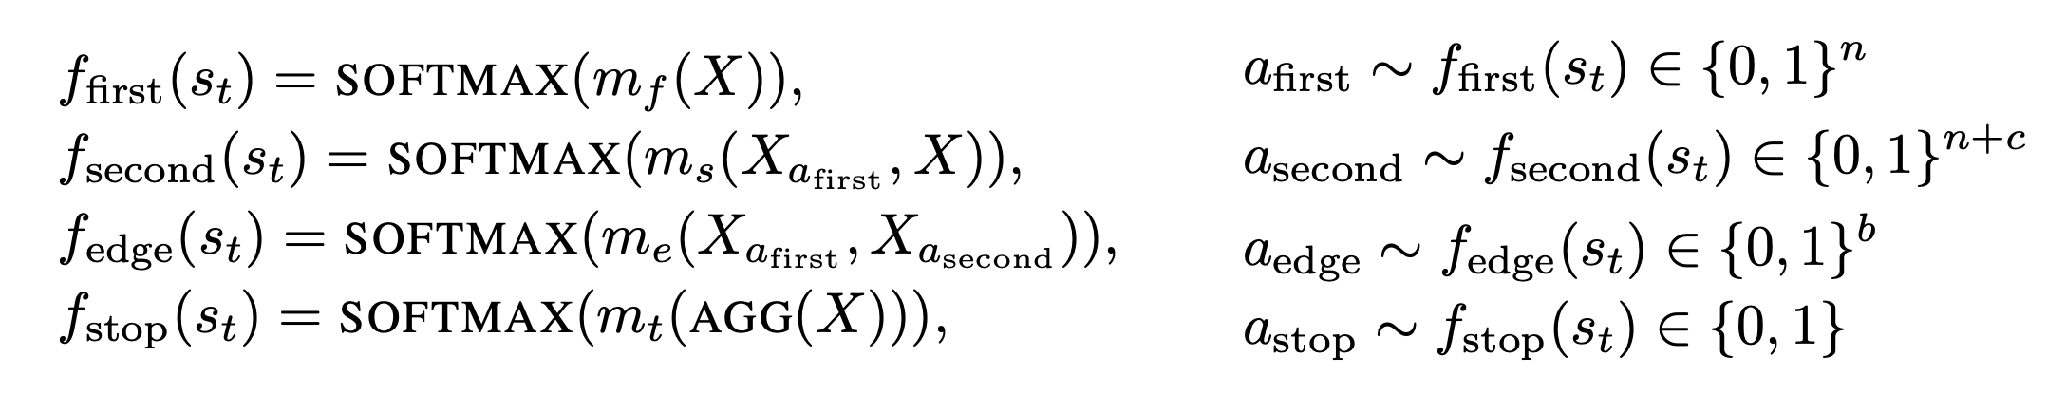
4. GCPN
2. Action Prediction
High Level: The action is sampled from the distribution.

Slide 37
4. GCPN
2. Action Prediction
M_{f} denotes multilayer perceptron, where it represents the probability distribution of selecting each node.
The selection of the first node passes to the second by concatenate its probability with the node in extended graph

Slide 38
4. GCPN
2. Action Prediction
M_{s} maps to selection of second node
M_{e} predicts the edge type
M_{t} maps the embedding to a scalar

Slide 39
5. Policy Gradient Training
GCPN predicts the action of the bond addition
GCPN is trained via policy gradient to optimize a reward composed of molecular property objectives and adversarial loss. The adversarial loss is provided by a graph convolutional network based discriminator trained jointly on a dataset of example molecules.
Adopted Proximal Policy Optimization (PPO)
Policy Gradient
PPO with Clipped Objective

Slide 40
5. Policy Gradient Training
Adopted Proximal Policy Optimization (PPO)
Policy Gradient
PPO with Clipped Objective

Slide 41
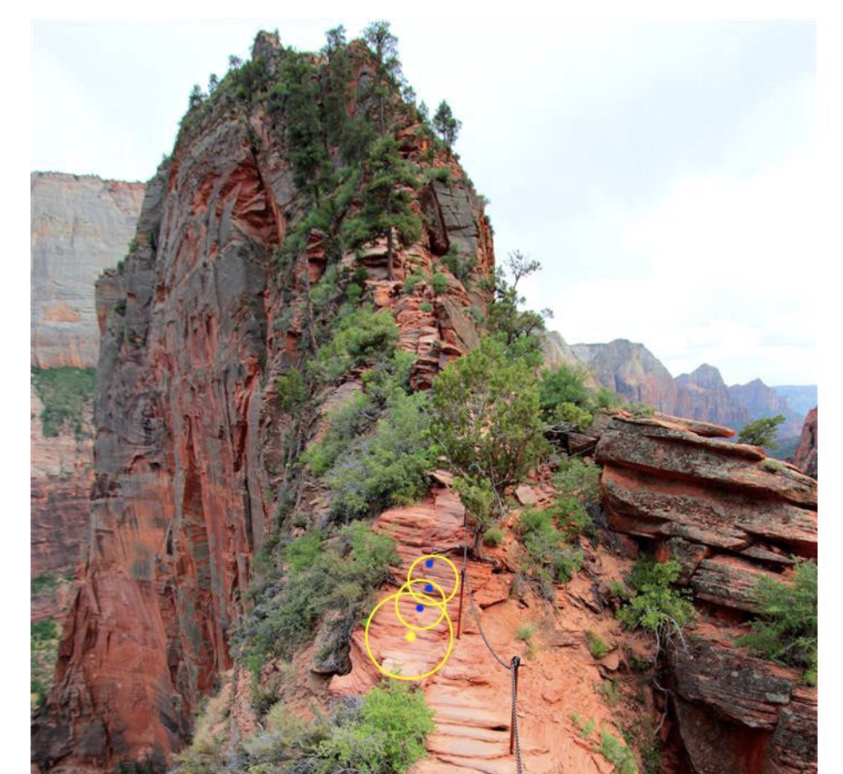
Policy Gradient
Necessity of Policy Gradient:
cannot undo the rewards
step size matters
Trust Region Approach:
Determine the maximal step we want to take first
Locate the optimal point within trust region
Source: https://jonathan-hui.medium.com/rl-proximal-policy-optimization-ppo-explained-77f014ec3f12

Slide 42
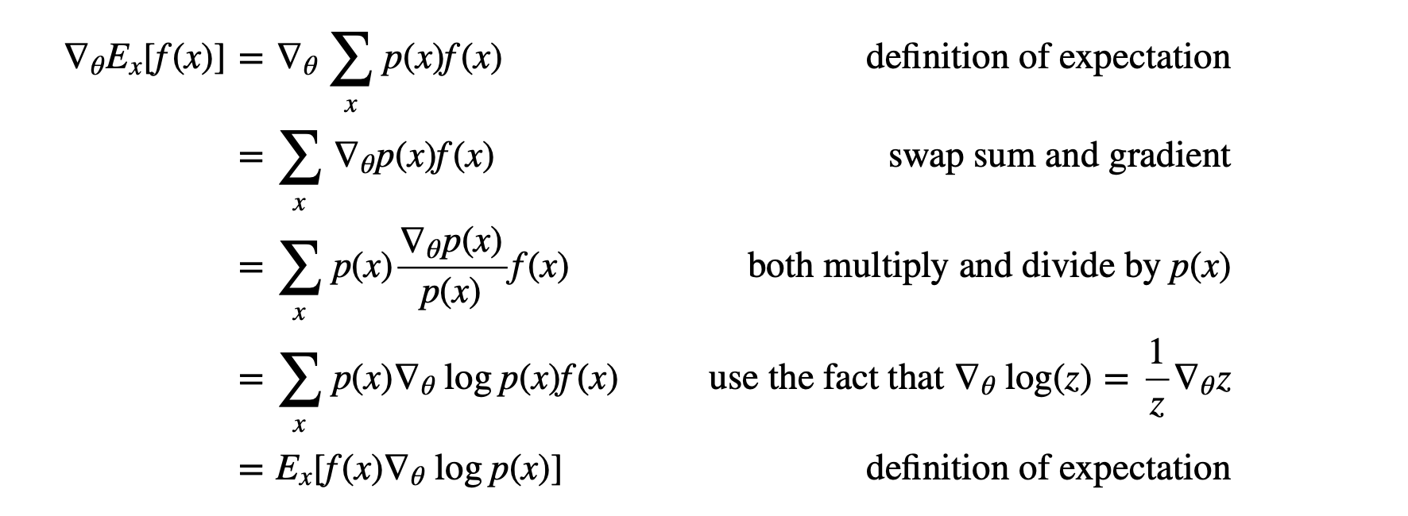
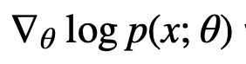
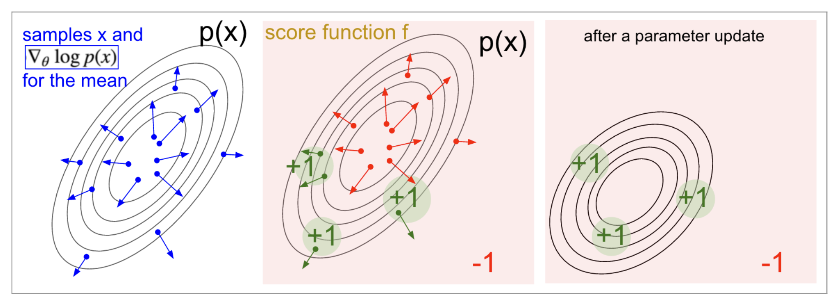
Policy Gradient
If we were to nudge θ in the direction
We are to expect increase in x.
Necessity of Policy Gradient: cannot undo the rewards; step size matters.
Source: http://karpathy.github.io/2016/05/31/rl/

Slide 43
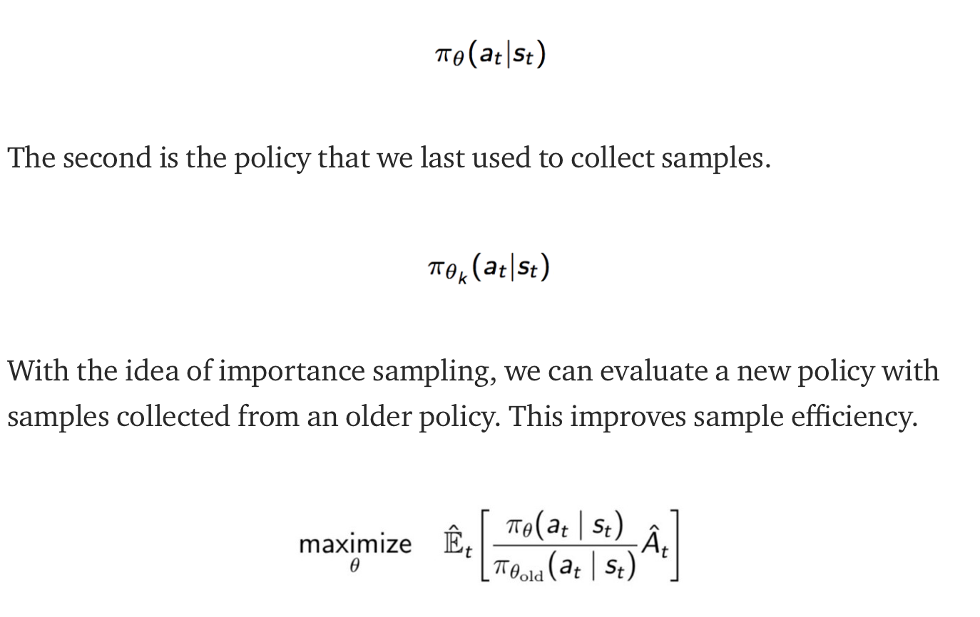
PPO with clipped distance
Maintain 2 policy networks
Source: https://jonathan-hui.medium.com/rl-proximal-policy-optimization-ppo-explained-77f014ec3f12

Slide 44
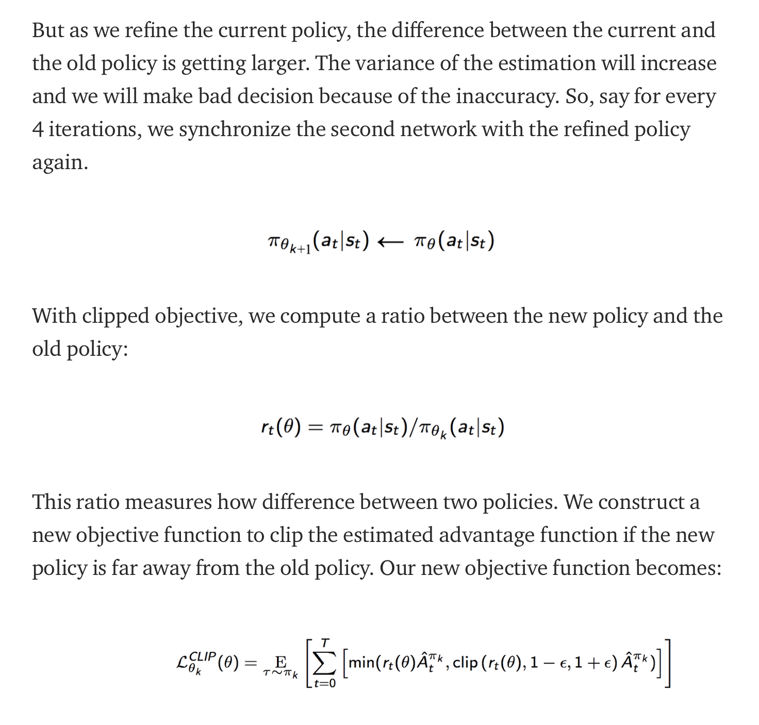
PPO with clipped distance
New objective:
Source: https://jonathan-hui.medium.com/rl-proximal-policy-optimization-ppo-explained-77f014ec3f12

Slide 45
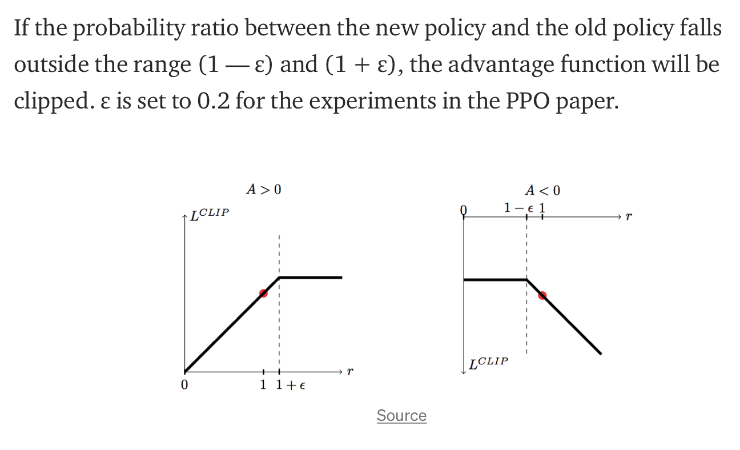
PPO with clipped distance
Source: https://jonathan-hui.medium.com/rl-proximal-policy-optimization-ppo-explained-77f014ec3f12

Slide 46
5. Policy Gradient Training
Adopted Proximal Policy Optimization (PPO)

Slide 47
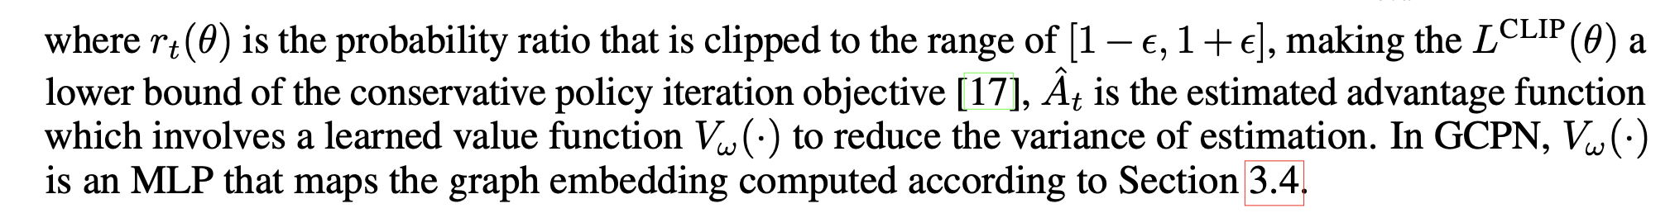
5. Policy Gradient Training
Adopted Proximal Policy Optimization (PPO)

Slide 48
Experiments

Slide 49
Experimental Setup
ZINC250k molecule dataset
Contains over 250,000 drug like commercially available molecules
RDKit OpenAI Molecule environment
To check validity of generated molecules
GCPN setup
3-layer defined GCPN
64 dimensional node embedding in all hidden layers
Batch normalization after each layer

Slide 50
Baselines
Junction Tree Variational Autoencoder (JT-VAE)
State-of-the-art algorithm for molecular generation
Objective-Reinforced Generative Adversarial Networks (ORGAN)
State-of-the-art algorithm for molecular generation using RL and text-based representation of molecules

Slide 51
Tasks
Property Optimization
Generate molecules while optimizing a score
Property Targeting
Generate molecules within a targeted score
Constrained Property Optimization
Generate new molecules on top of a given substructure while optimizing a score

Slide 52
Experiment Results
Task 1: Property Optimization
Generating molecules with greatest penalized logP and QED scores
logP is the logarithm of the octanol-water partition coefficient
Score for how soluble a molecule is in water and fat
Penalized logP also takes into account ring size and synthetic accessibility
QED is an indicator of druglikeness from [0-1]

Slide 53
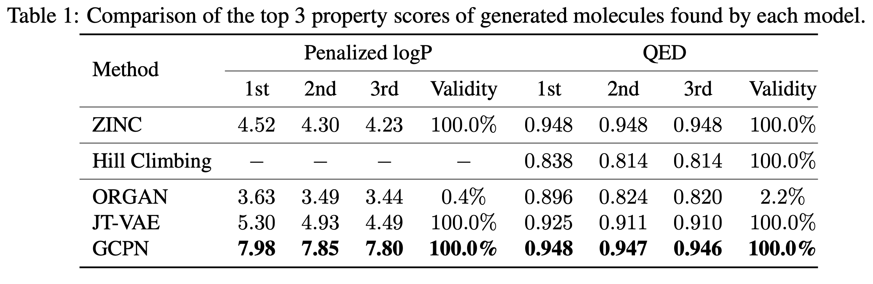
Task 1: Property Optimization Results

Slide 54
Experiment Results
Task 2: Property Targeting
Set a targeted range of molecular weight (MW) and logP
Measure success rate and diversity
Success is the percentage of generated molecules that fall within the targeted range
Diversity is the average pairwise Tanimoto distance between the Morgan fingerprints of the molecules

Slide 55
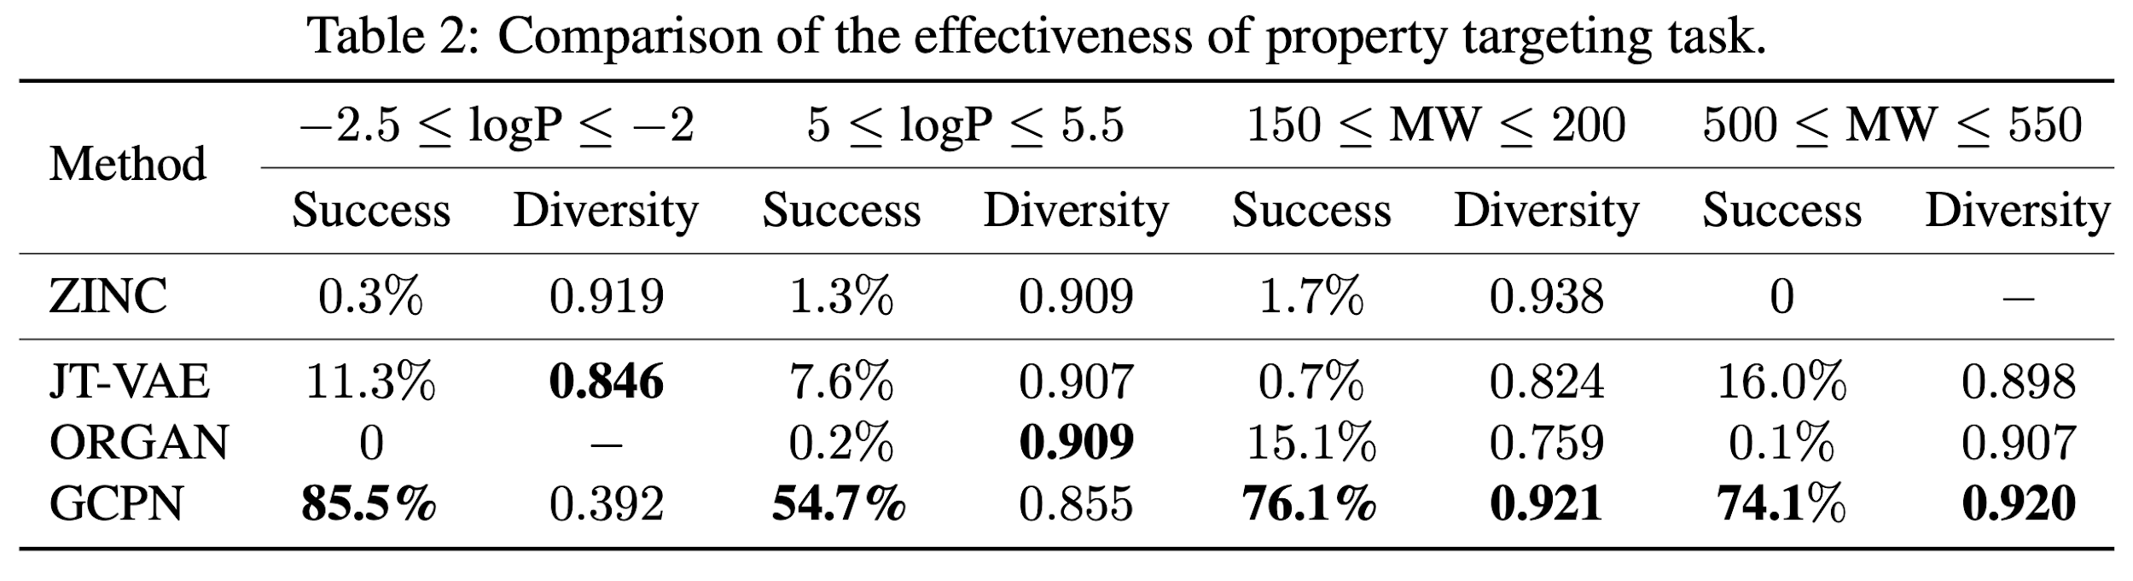
Task 2: Property Targeting Results

Slide 56
Experiment Results
Task 3: Constrained Property Optimization
Generate molecules that contain a base substructure/molecule (one of 800 ZINC molecules)
Base substructure/molecule has a low penalized logP so they measure the improvement of the penalized logP of the generated molecule
Penalized logP is being optimized
The baseline JT-VAE algorithm cannot constrain generated molecules to have a certain substructure. Therefore, they relaxed the constraint so the generated molecule must have a similarity score above a threshold 𝛿.

Slide 57
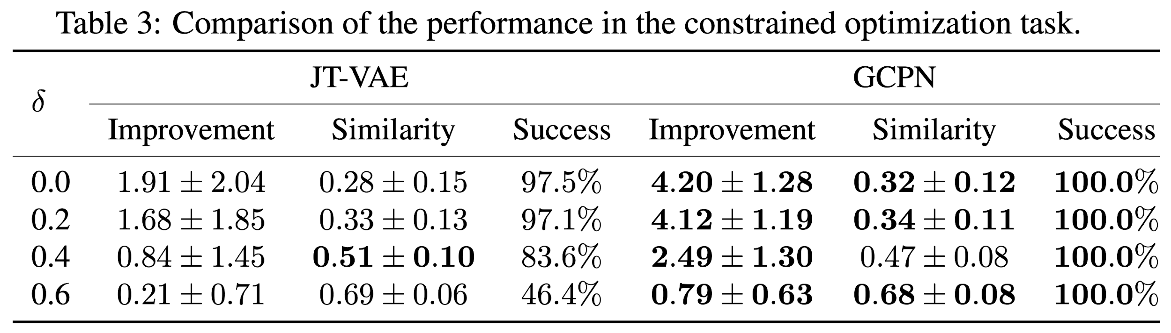
Task 3: Constrained Property Optimization

Slide 58
Demo

Slide 59
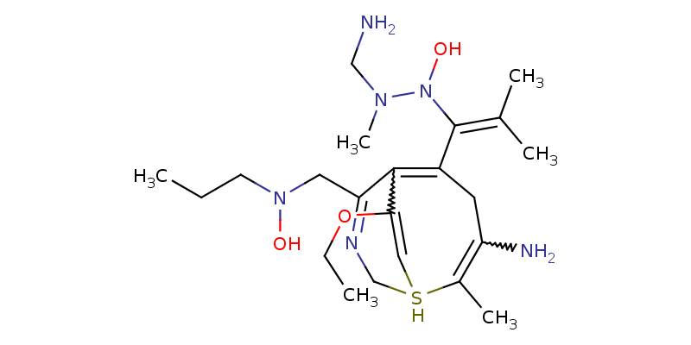
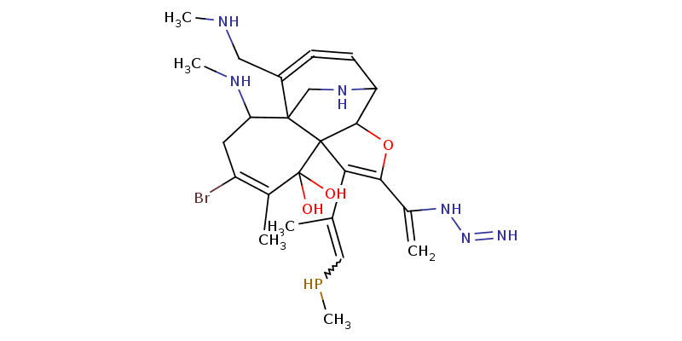
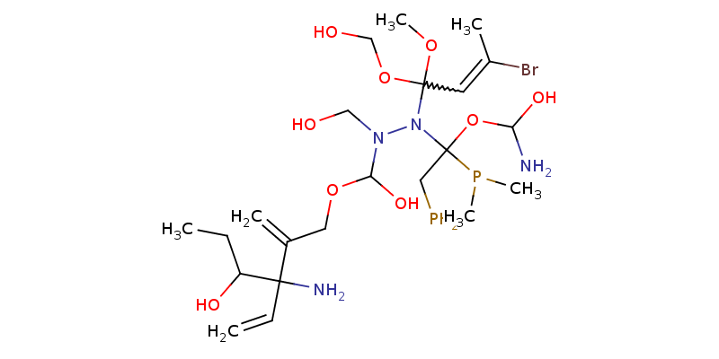
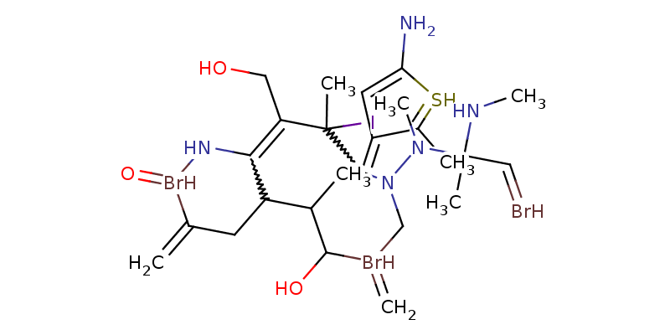
Example Molecules Generated

Slide 60
Discussion

Slide 61
Pros
Graph Representation
GCPN directly models molecules as molecular graphs.
The text based representations such as SMILES (simplified molecular-input line-entry system) are vulnerable to even simple perturbation.
Partially generated molecular graphs can be interpreted as substructures, whereas partially generated text representations might not be meaningful.
Reinforcement Learning
Better than generative model since
It could model hard constraints and chemical properties which are not differentiable
It allows active exploration outside datasets

Slide 62
Pros
Optimization:
This approach allows direct optimization of application-specific objectives, while ensuring that the generated molecules are realistic and satisfy chemical rules.
Performance:
In all tasks, GCPN achieves state-of-the-art results.
GCPN generates molecules with property scores 61% higher than the best baseline method, and outperforms the baseline models in the constrained optimization setting by 184% on average.

Slide 63
Cons
No guarantees of synthesizability
Simply provides a chemically valid graph, but fails to have a documented synthesis path
Scaling
Since GCPN operates iteratively, scaling graph generation may prove difficult since each action only contributes a single edge

Slide 64
Conclusions

Slide 65
Closing Remarks
GCPN is a graph generation policy network using graph state representation and adversarial training, applied to the task of molecular graph generation
SOTA in molecular property optimization and targeting, while maintaining integrity to realistic molecules.
GCPN can be modified with other domain specific rewards to be applied to other fields

Slide 66
Q & A

Slide 67
Thanks for Listening!

Slide 68
Reference
RL, Proximal Policy Optimization (PPO) Explained.https://jonathan-hui.medium.com/rl-proximal-policy-optimization-ppo-explained-77f014ec3f12
Generative Adversarial Network. https://developers.google.com/machine-learning/gan/generator
Deep Reinforcement Learning: Pong from Pixels. http://karpathy.github.io/2016/05/31/rl/
Proximal Policy Optimization. https://openai.com/blog/openai-baselines-ppo/

